Slide 1
SciGraph
Chris Condit
August 2015 - condit@sdsc.edu

Slide 2
Overview
Ontologies
NoSQL / Neo4j
Biological Use Cases

Slide 3
Ontologies
“An ontology is a formal, explicit specification of a shared conceptualization.”
Studer et al. 1998
Sometimes data
Sometimes vocabulary
Sometimes semantic
Notes:
Multi-hierarcy

Slide 4
Ontologies
<owl:Class rdf:about="#CA1">
<rdfs:label xml:lang="en">CA 1 Cell</rdfs:label>
<rdfs:subClassOf>
<owl:Class rdf:about="#Hippocampus"/>
</rdfs:subClassOf>
<rdfs:subClassOf>
<owl:Restriction>
<owl:onProperty rdf:resource="#hasNeuron"/>
<owl:someValuesFrom rdf:resource="#PyramidalNeuron"/>
</owl:Restriction>
</rdfs:subClassOf>
</owl:Class>

Slide 5
Ontology Fragment
Hippocampus
has_part
CA1
CA2
CA3
CA1 Alveus
CA1 Stratum Oriens
CA1 Stratum Radiatum

Slide 6
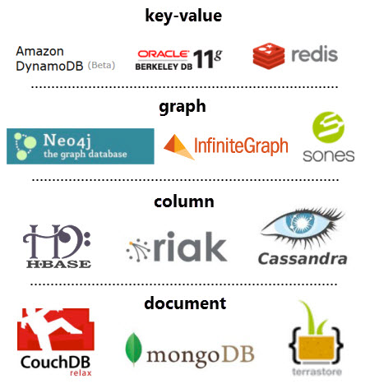
NoSQL
Not “No SQL”
but
“Not Only SQL”
or better yet:
“nonrelational databases”

Slide 7
Property Graph Data Model
title: Effective Java
author: Joshua Bloch
Book
:READ {year:2005}
:READ {year: 2009}
Person
Researcher
Person
name: Chris
title: Engineer
Developer
name: Sally
title: Specialist
:WORKS_WITH

Slide 8
Neo4j
Schema-less
Open source friendly license
Traversals
Algorithms
but…
No number crunching / aggregate global analysis
No binary data / blobs / objects
Cypher is Neo4j specific
Conceptual shift

Slide 9
SciGraph Goals
Represent ontological data in Neo4j
Support OWL 2 semantics
Domain agnostic
Support graph operations
Support vocabulary operations
Support annotation operations
Provide basic REST services

Slide 10
What SciGraph Isn’t
Does not “round trip” ontologies
SciGraph is “lossy”
Not a magical ontology management system
Does not manage or version ontologies
Is not a primary store of data
Does not support CRUD operations

Slide 11
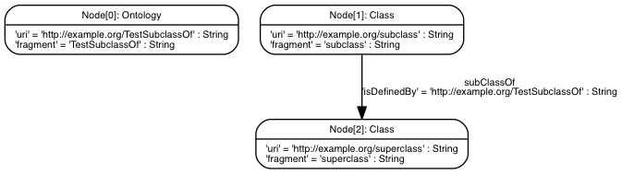
OWL Mapping Example 1
Prefix(:=<http://example.org/>) Ontology(:TestSubclassOf SubClassOf(:subclass :superclass) )

Slide 12
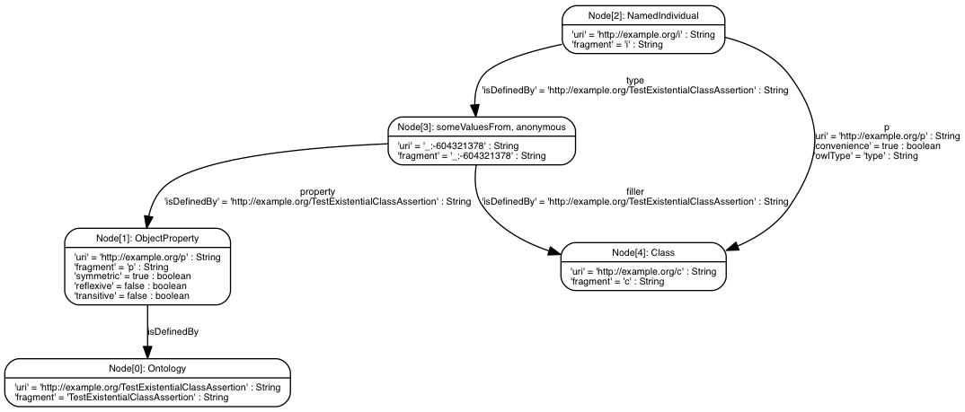
OWL Mapping Example 2
Prefix(:=<http://example.org/>) Ontology(:TestExistentialClassAssertion Declaration(ObjectProperty(:p)) ClassAssertion(
ObjectSomeValuesFrom(:p :c) :i) )
https://github.com/SciGraph/SciGraph/wiki/Neo4jMapping

Slide 13
Cypher
[MATCH WHERE] [OPTIONAL MATCH WHERE] RETURN [ORDER BY] [SKIP] [LIMIT]
http://neo4j.com/docs/stable/cypher-refcard/

Slide 14
Biological Graph Pattern
OMIM
Panther
DO
Disease 1
Human Gene 1
Ortholog Gene 1
subClassOf
hasPhenotype
orthologousTo
Biogrid
Neurodegenerative Disease
interactsWith
interactsWith
OMIM
Panther
subClassOf
Disease 2
Human Gene 2
Ortholog Gene 2
hasPhenotype
orthologousTo
What diseases are linked to genes that interact via orthology?
Notes:
Query construction
Edge pattern removal
Really linking across heterogeneous data sources

Slide 15
Biological Cypher Query
START disease = node:node_auto_index(id='DOID_1289')
MATCH
(disease)<-[:subClassOf*]-(d1)<-[:RO_0002200]-(hg1)-[:orthologous]-(mg1),
(disease)<-[:subClassOf*]-(d2)<-[:RO_0002200]-(hg2)-[:orthologous]-(mg2),
(hg1)-[:interactsWith]-(hg2),
(mg1)-[:interactsWith]-(mg2)
WHERE d1.id > d2.id
RETURN mg1, hg1, d1, mg2, hg2, d2
What diseases are linked to genes that interact via orthology?
Notes:
A bit of a simplification - note that interactsWith includes all sub types of interaction (or really any configuration)

Slide 16
Biological Graph Pattern
Abnormal Phenotype
hasPhenotype
Chromosome
Disease
isSubsequenceOf
hasPhenotype
Gene
Genes on each chromosome linked to abnormalities
Notes:
Query construction
Edge pattern removal
Really linking across heterogeneous data sources

Slide 17
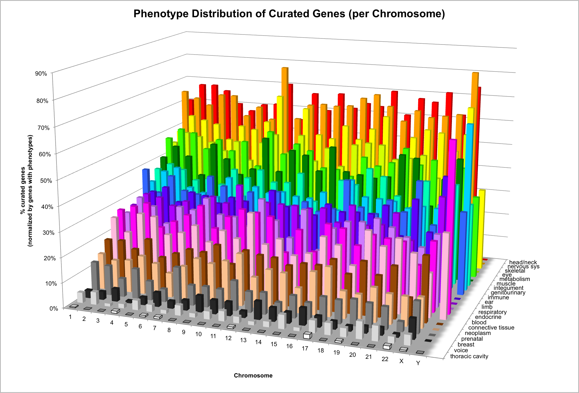

Slide 18
Resources
https://github.com/SciGraph/SciGraph
http://neo4j.com/
http://neo4j.com/graphacademy/online-course/

